Slide 1
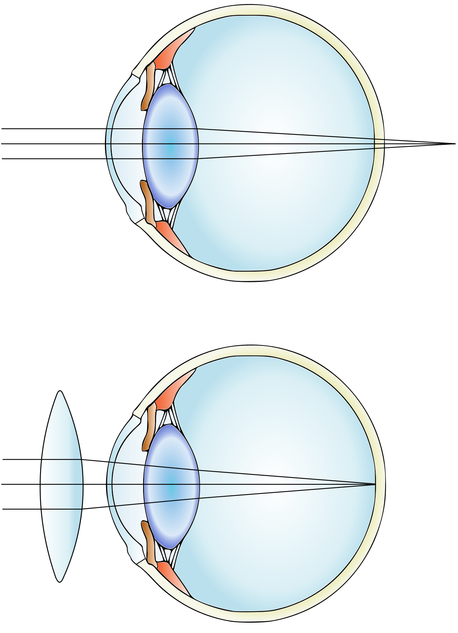
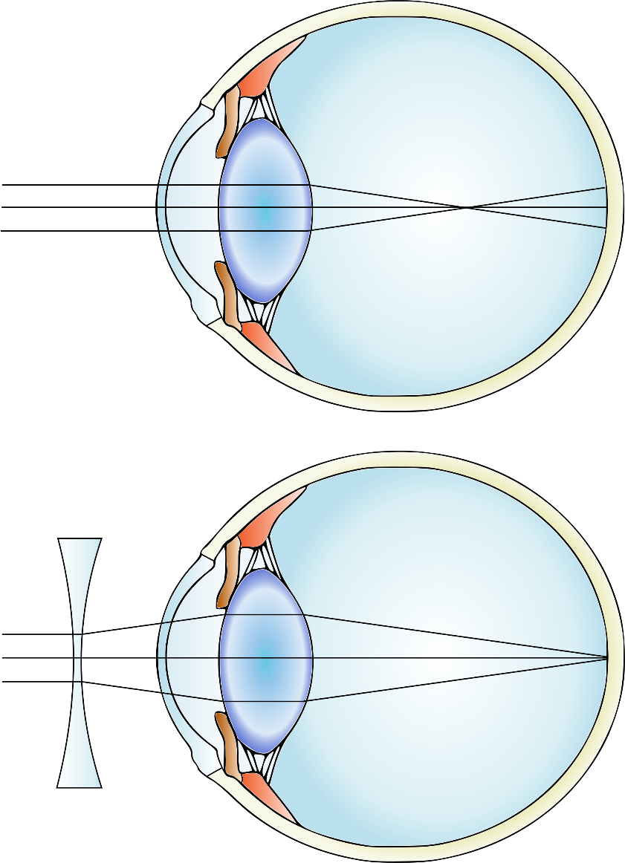
Farsightedness (Hyperopia) and Nearsightedness (Myopia)
hyperopia
myopia
correction
correction

Slide 2
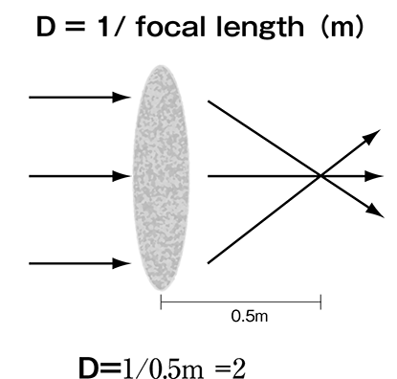
Refractive Power (RP) of lens
Diopter (D) is the reciprocal number of the focal length (measured in meter). It represents the refractive power (RP) of the lens. Convex lenses have a +ve diopter, whereas concave lenses have –ve diopter.
What is emmetropic vision?

Slide 3
Definitions
What is hyperopia?
Hyperopia, also known as farsightedness, is a common type of refractive error where distant objects may be seen more clearly than objects that are near. For people with significant hyperopia, vision can be blurry for objects at any distance, near or far.
What is myopia?
Otherwise known as nearsightedness, myopia occurs when the eye grows too long from front to back. Instead of focusing images on the retina, the lens of the eye focuses the image in front of the retina. People with myopia have good near vision but poor distance vision.
What is binocular vision???

Slide 4
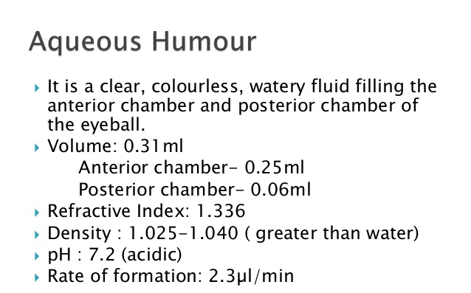
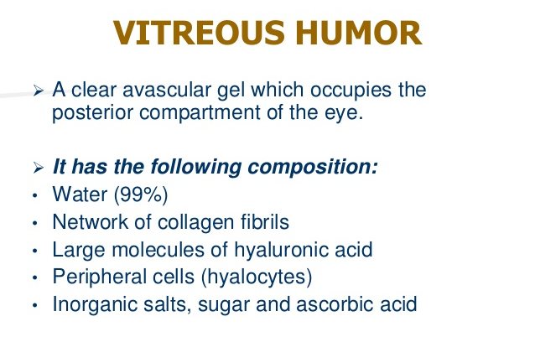
Fluid System of the EYE – Intraocular Fluid
Keeps the eyeball round and distended by maintaining pressure.
Two chambers – Aqueous and Vitreous.
Aqueous humor – free flowing fluid in front of the lens.
Vitreous humor – gelatinous mass with little flow of fluid at the back of the lens.

Slide 5
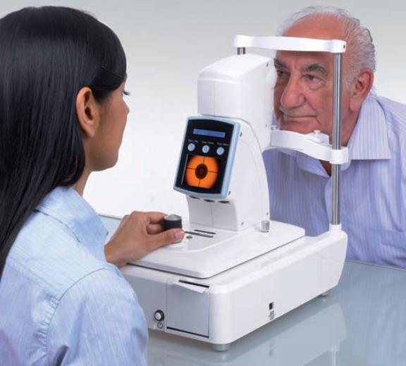
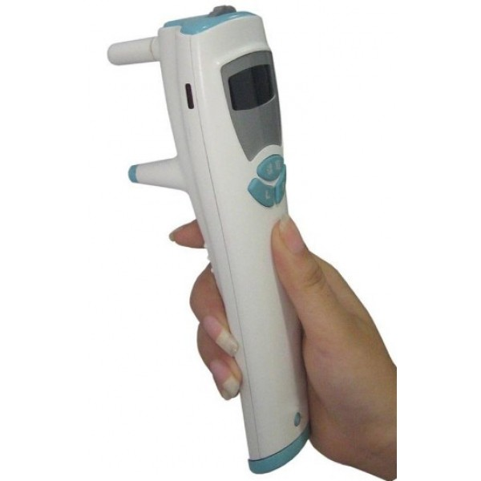
Ocular tonometry
Procedure to measure intraocular pressure (IOP), i.e. the fluid pressure inside the eye.
Important test to evaluate the risk of glaucoma.
Different types of tonometers are available based on various techniques.
What is tonometer?
Tonometer is a device that measures intraocular pressure (IOP).

Slide 6
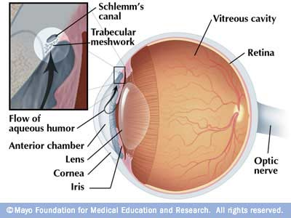
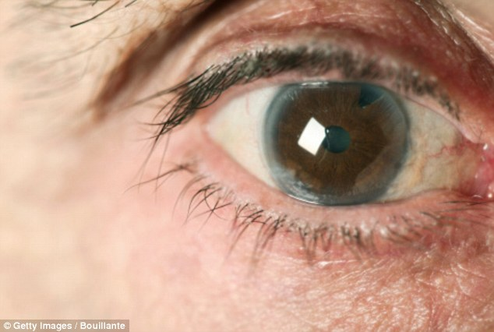
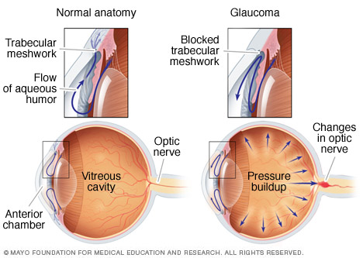
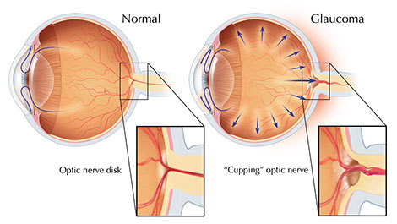
Glaucoma

Slide 7
Glaucoma – the process
Eye pressure rises
Surgical treatments:
Laser Trabeculoplasty
Trabeculectomy
The axons of the optic nerve are compressed
Block axonal flow of cytoplasm from the neuronal cell bodies in the retina to the extended optic nerve fibres entering the brain
What is a cataract then?
Lack of appropriate nutrition of the fibres
Causes death of the involved fibres

Slide 8
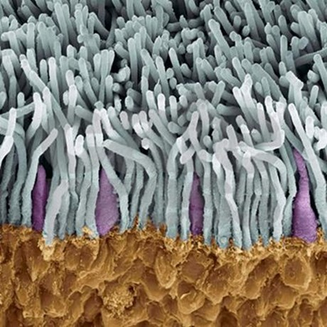
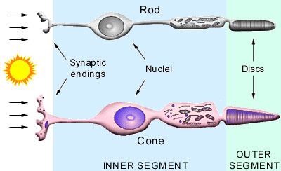
Photoreceptors – Rods and Cones
Why no colour in dim light!!!
6 million cones and 120 million rods
Rods are responsible for night vision; Cones provide colour vision in brighter light.
Blue
Green
Red
Lost rod vision? Should not drive at night.
Lost cone vision? Should not drive at all !
SEM image of rods and cones

Slide 9
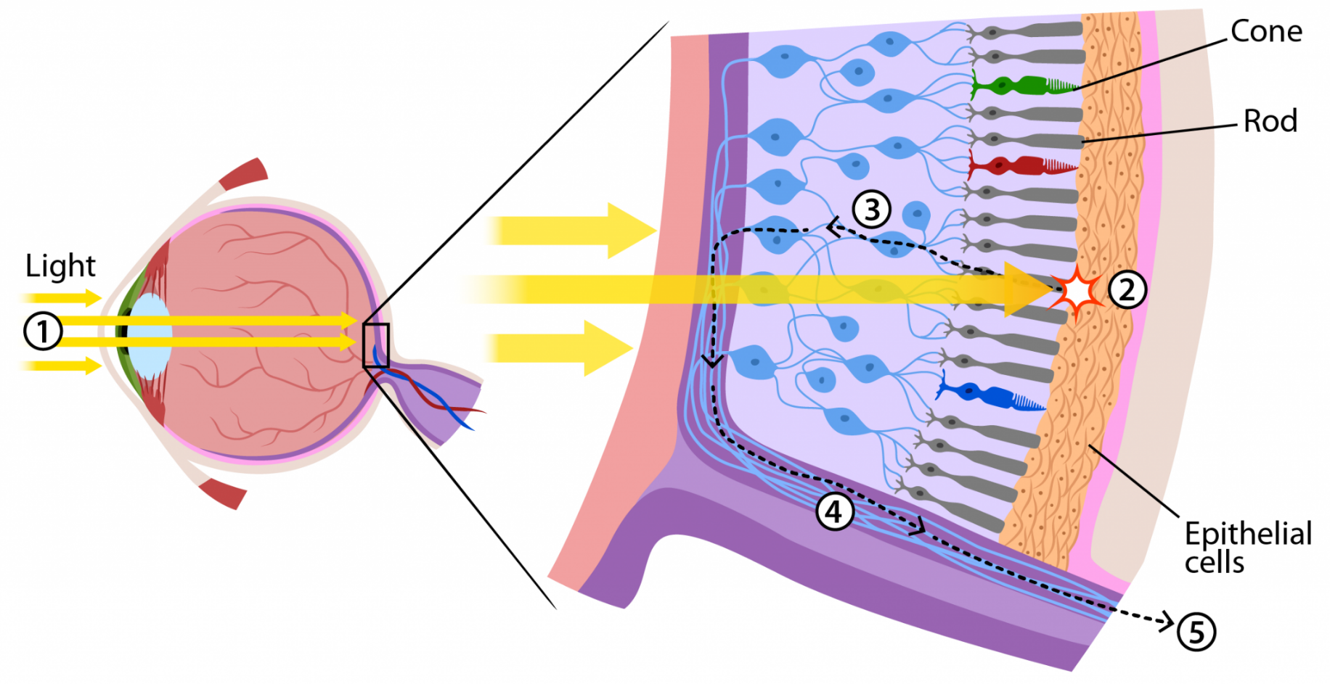
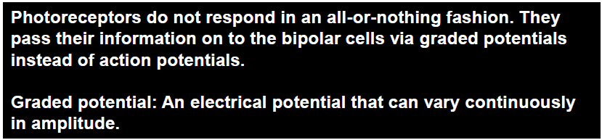
Flow of image information
Ganglion cell
Bipolar cell
Chromophore: The light-catching visual pigments of the retina found in cones.
Rhodopsin: The visual pigment found in rods.

Slide 10
What is Night Blindness?

Slide 11
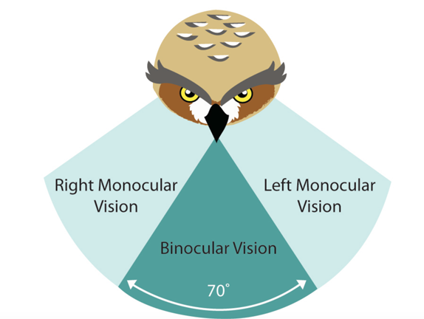
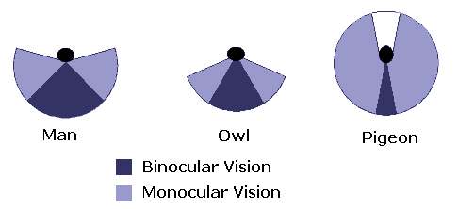
Bird vision
Good eyesight is essential for safe flight!
Avian eye resembles that of a reptile, with ciliary muscles that can change the shape of the lens rapidly and to a greater extent than in the mammals.
Birds have the largest eyes relative to their size in the animal kingdom.
Avian eye is protected by a third transparent movable membrane.
Birds of prey have a very high density of receptors to maximise visual acuity.
Nocturnal birds have tubular eyes, low no. of colour detectors, but a high density of rod cells to function well in poor light.

Slide 12
Let’s try something interesting …
Did you feel the blind spot in your right eye ???

